Slide 1

Observability: Visualize, Analyze, Troubleshoot
How metric, alerts, and dashboards to enhance security, empower developers and operations, and control cost.

Slide 2
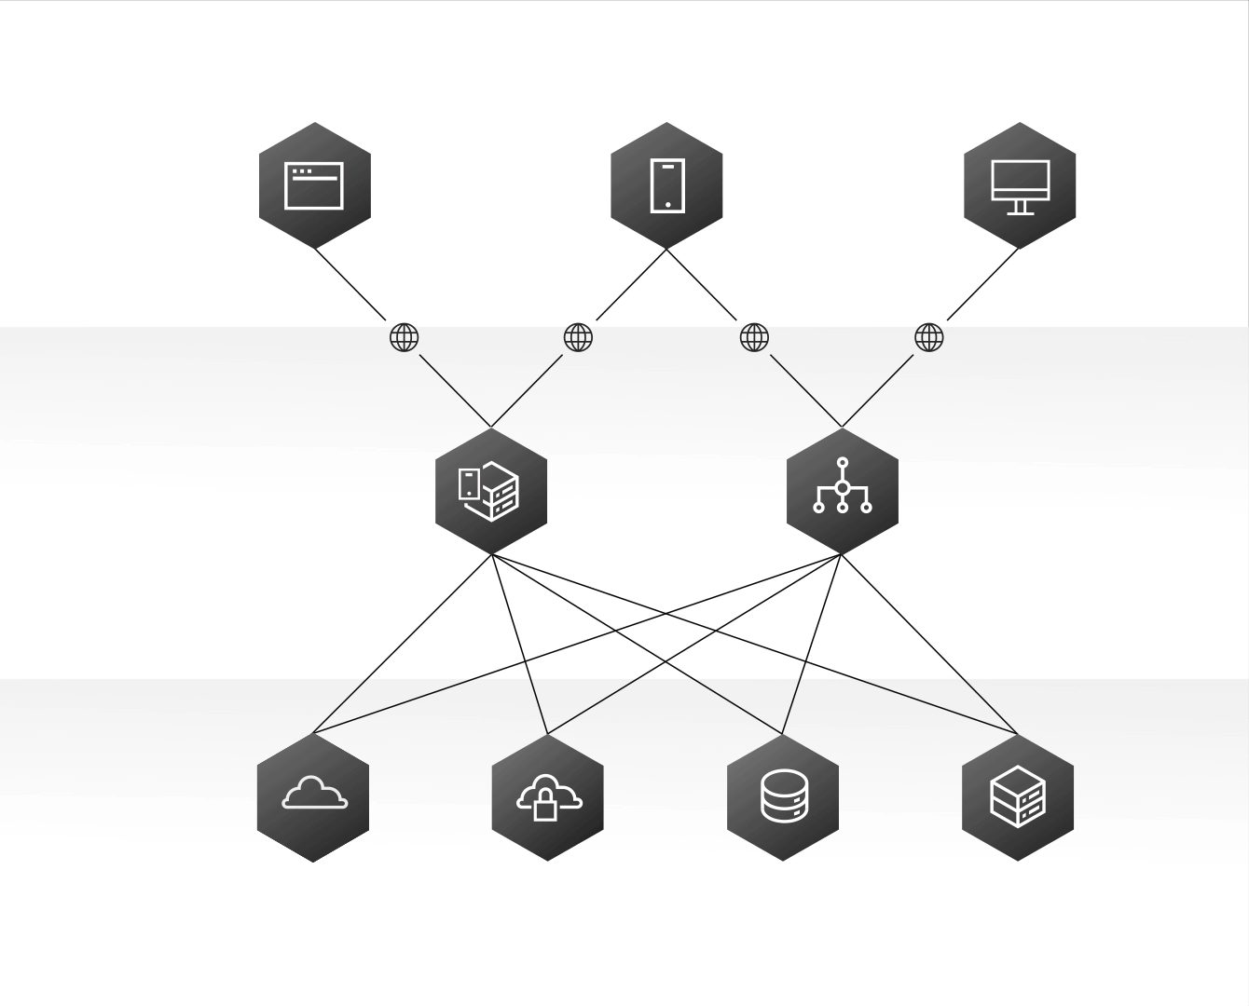
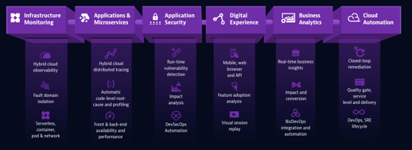
Agenda
Application / Front-end
Mobile Developers
Web Developers
Challenge
Hybrid-Cloud
Nomenclature Standardization
Metrics as Code
Everything is a Terraform Module
Extending Terraform with Configuration
Honest Metrics
Day to Day
Incident Management
Service Visualization
Application Performance Monitoring (APM)
Logging
Infrastructure Monitoring
Synthetic Monitoring
Real User Monitoring
Security Monitoring
Cloud Security Posture Management (CSPM)
Methodology of Selection
Application / Back-end
Application Developers
Software Engineers
Customer Support
Product Teams
Infrastructure
Systems Admins
Cloud Infra Teams
DevOps Teams

Slide 3
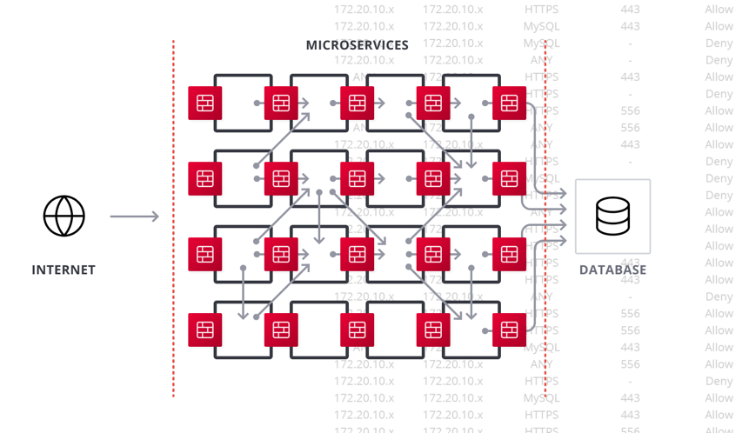
The Challenge of Distributed Architectures
Moving from cows to cattle
Service Oriented Moving from IP controls to service naming and tagging nomenclature to define security, networking, and observability boundaries.
Increasing Complexity
From cross-cloud to SaaS to microservices, an application’s landscape has dramatically transformed.
Ephemeral
Flexible and fault-tolerant solutions to support containers, that may exist for seconds, to entire temporary ecosystems.
Domain Driven
Clearly defining and enforcing certain naming patterns to ensure metrics are consistent and domain aligned.
= Network Middleware (FWs, LBs, API Gateways, etc..)

Slide 4
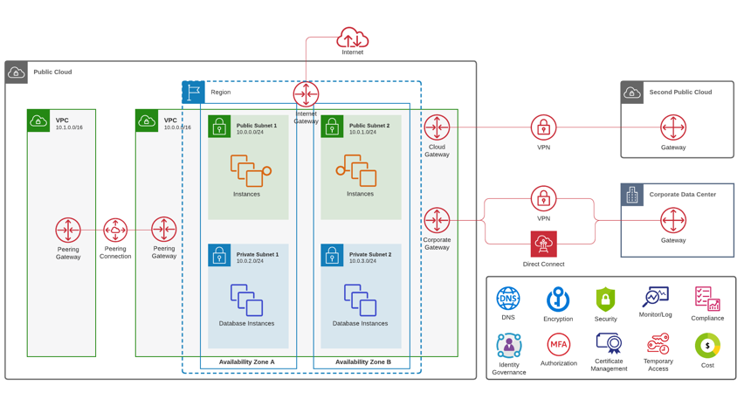
Hybrid, Multi-Cloud Strategy
How to build a modern Zero-Trust backbone that will protect the Enterprise while accelerating the return of value?
Security Insights:
Which applications are encrypted?
How many applications are actively blocking threats?
Which apps are protected by a WAF?
Operational Insights:
Which apps are at risk of service disruption?
What percent of time was my app available?
What was the average response time for my apps?
Why is my app down?
Cost insights:
How many apps are deployed elastically?
Where are my idle and underutilized resources?
Which environments are using what percent of my budget?

Slide 5
Nomenclature Standardization
Setting up global standards to do system-wide analysis
Metrics Explorer - Explore all of your metrics and perform Analytics.
Metrics Types - Types of metrics that can be submitted.
Advanced Filtering - Filter your data to narrow the scope of metrics returned.
Metrics Summary - Understand your actively reporting metrics.
Distribution Metrics - Learn about Distribution Metrics and globally accurate percentiles.

Slide 6
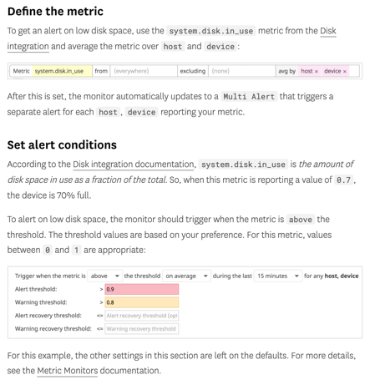
Metrics as Code
Unified tooling from DEV to PROD
System: CPU / File Handle / IO/ Load / Memory / Uptime / Winproc
Other: Disk / Network / Docker / NTP
Custom: Agent / Crawler / Library (api)

Slide 7
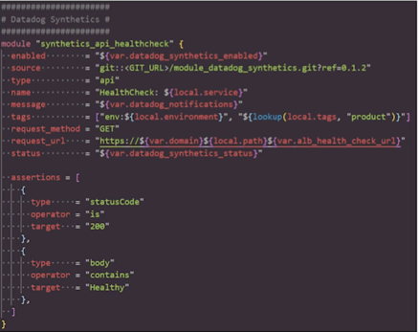
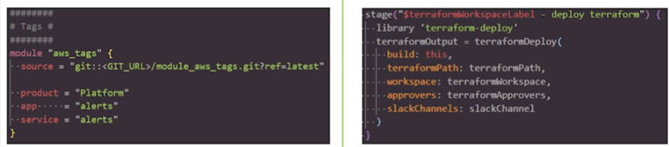
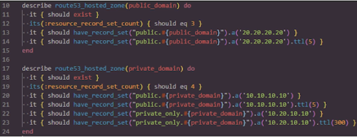
Everything is a Terraform Module
Build your core monitoring and logging side-by-side with your application and infrastructure definitions
Define Tags and Variables
Include monitoring as a Terraform Module
Execute it from CI/CD
Test
Everything as Code

Slide 8
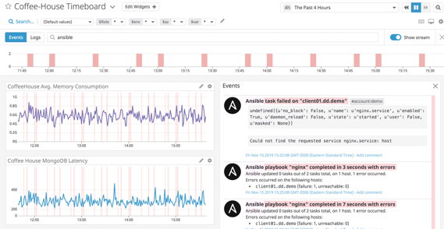
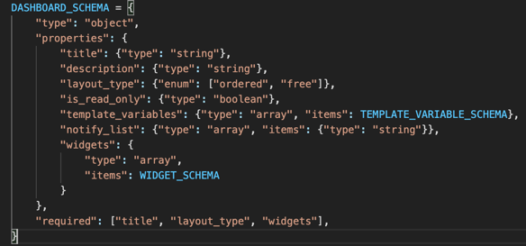
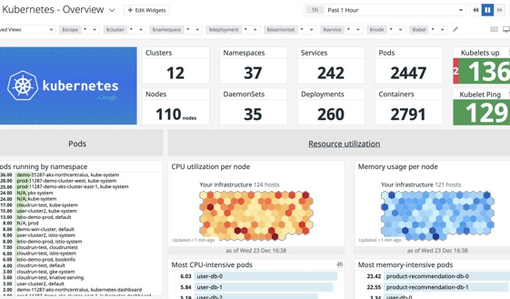
Extending Terraform with Configuration
Not everything needs to be HCL

Slide 9
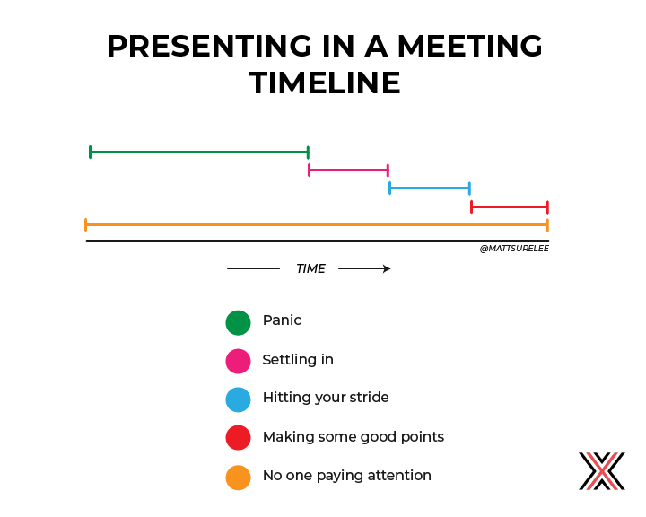
Honest Metrics

Slide 10
Day to Day
Have a hypothesis (introducing Kafka-Connect + Spark to increase performance and reduce cost)
Clarify features (10x growth, reduce cost, easily scale, replay data)
Figure out how to test this hypothesis (decouple state and compute)
Build and experiment (kafka-connect memory, multipart uploads, byte buffers, etc)
Measure and validate (unit test, integration tests, load-test, slowest parts, data correctness, game days)
Release
We figured out the optimal size of buffers to avoid out of memory issues that we had before…we discovered them by monitoring the system.
https://www.youtube.com/watch?v=3tICXGVFBDY

Slide 11
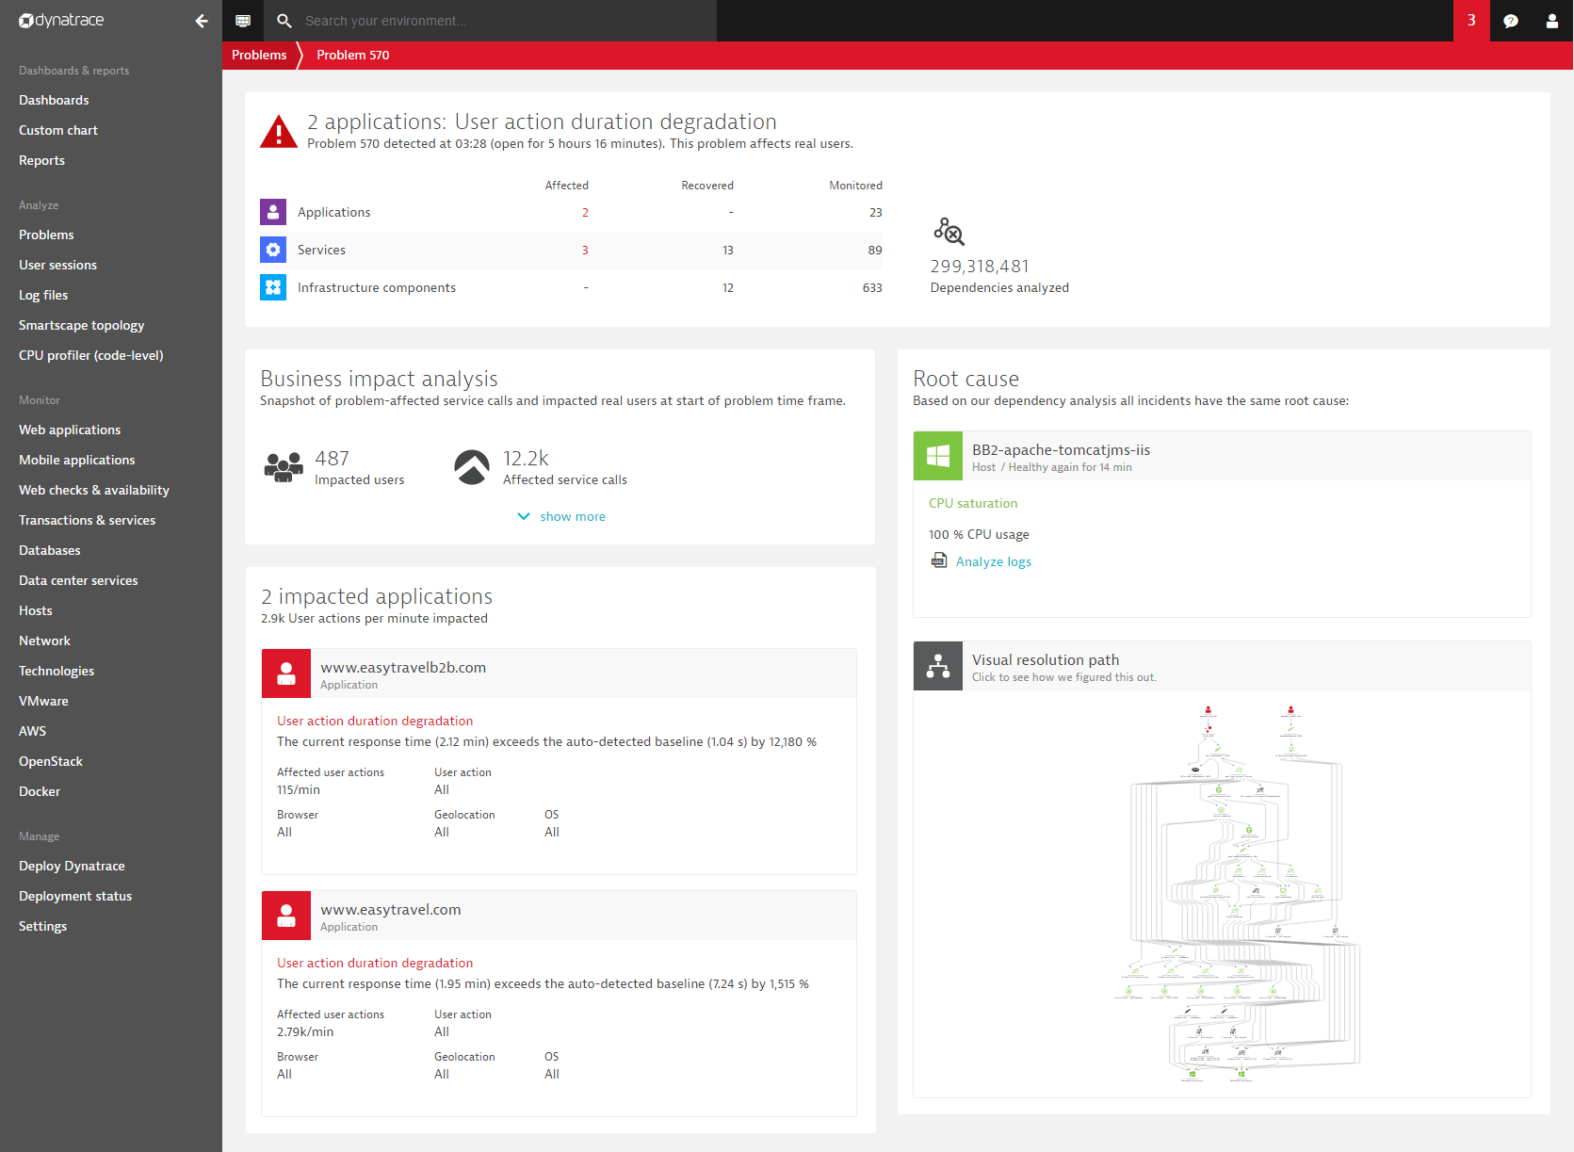
Incident Management

Slide 12
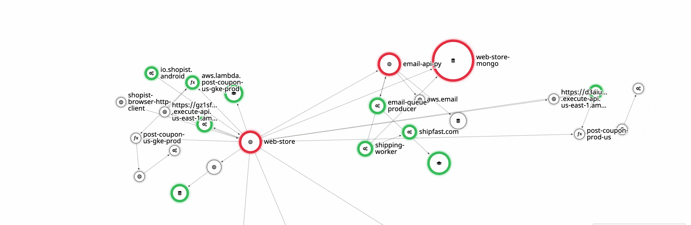
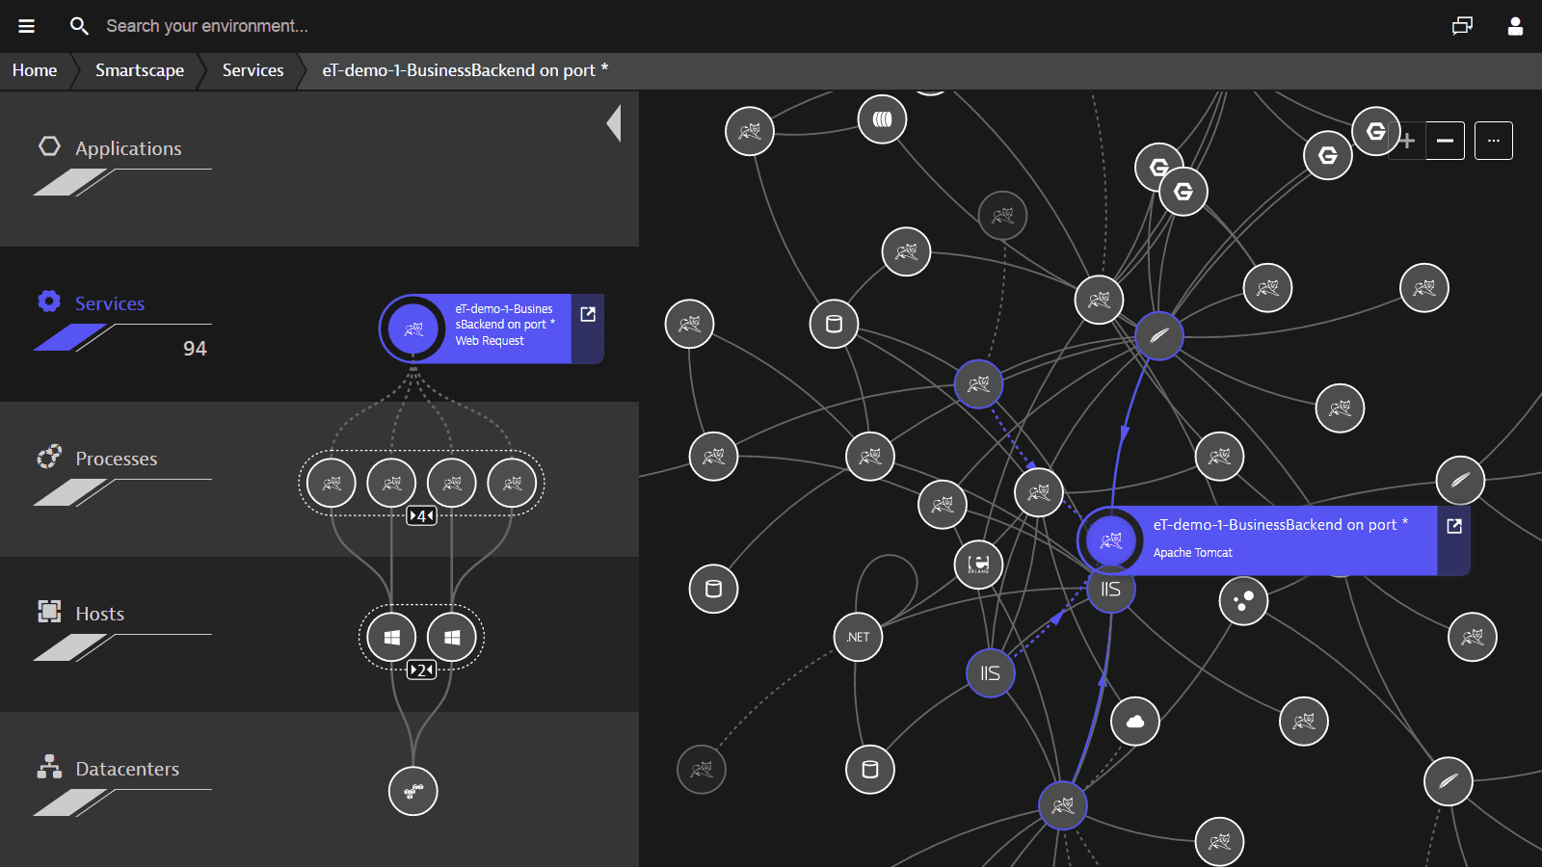
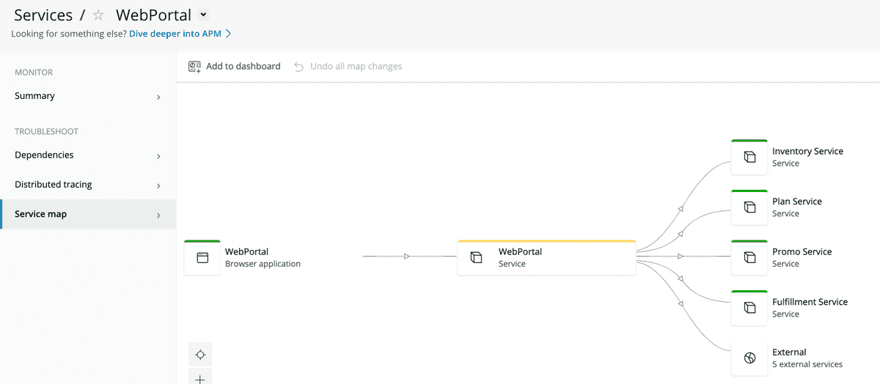
Service Visualization

Slide 13
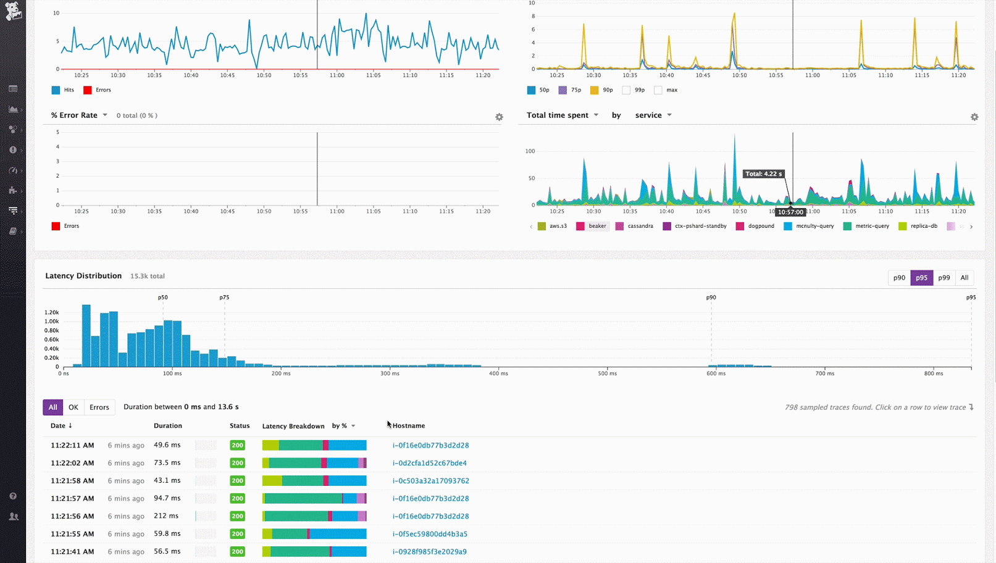
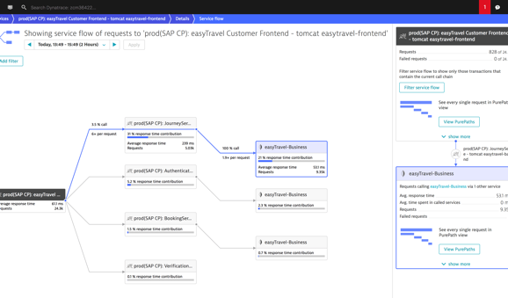
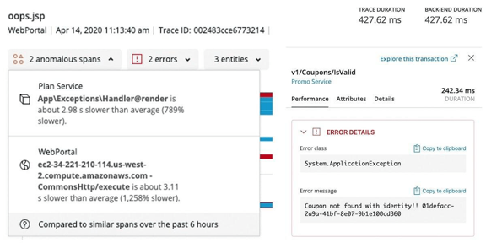
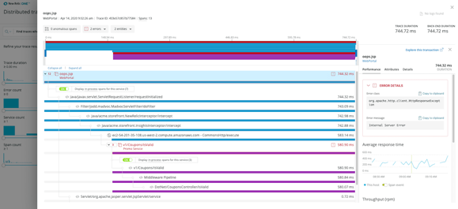
Application Performance Monitoring (APM)

Slide 14
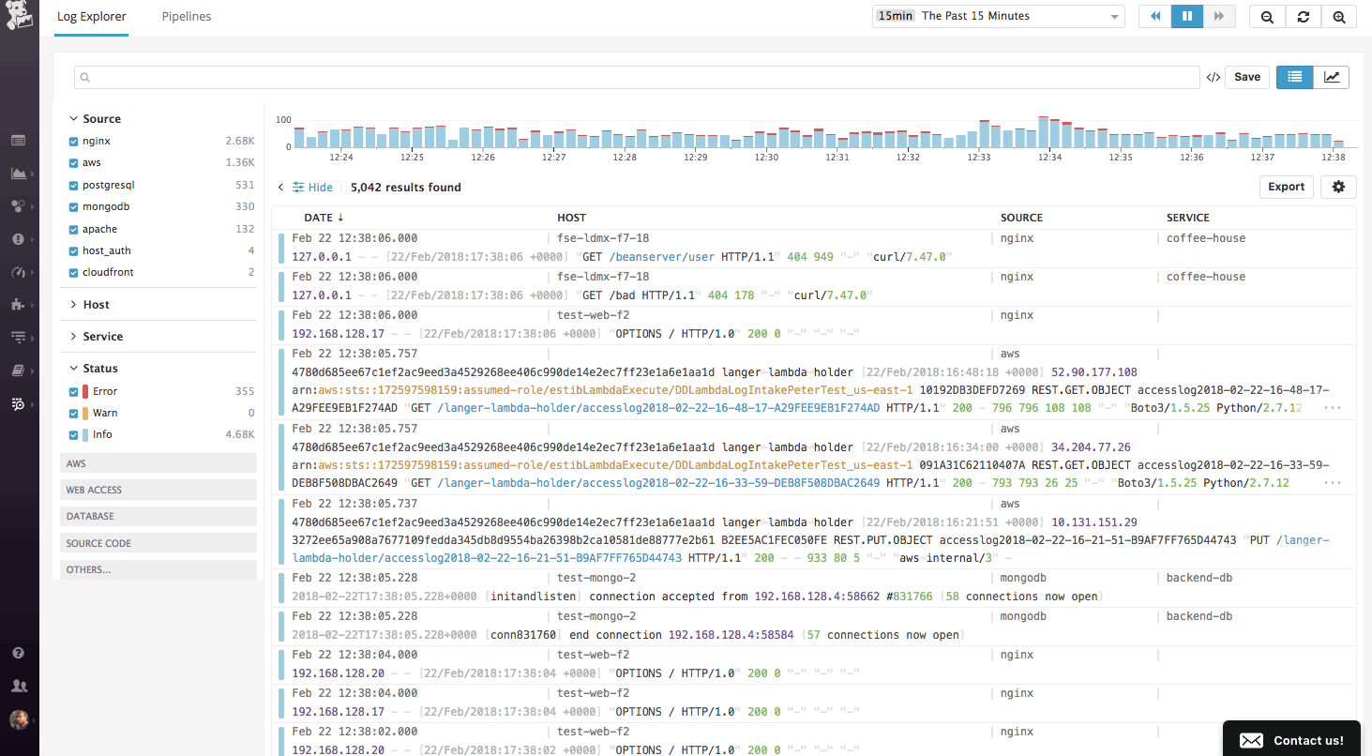
Logging

Slide 15
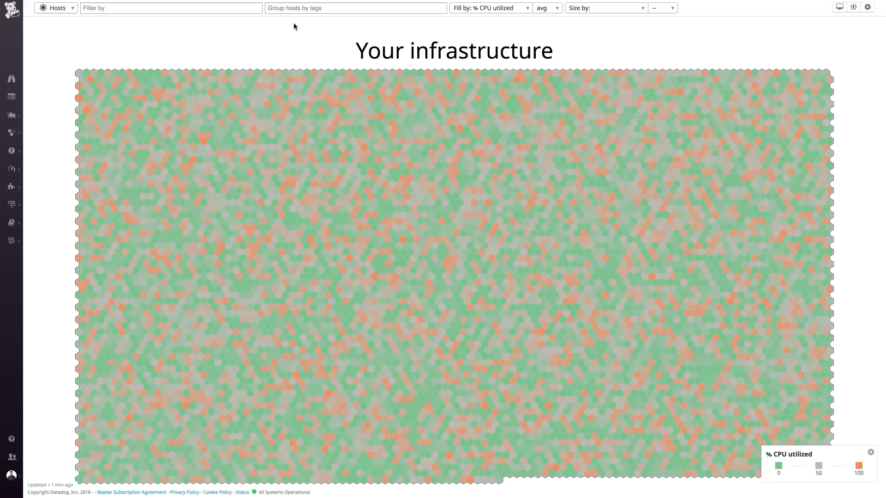
Infrastructure Monitoring

Slide 16
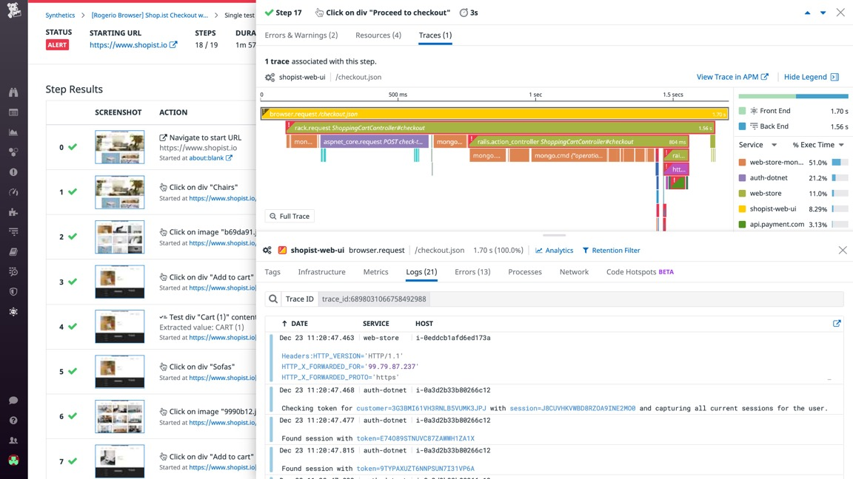
Synthetic Monitoring

Slide 17
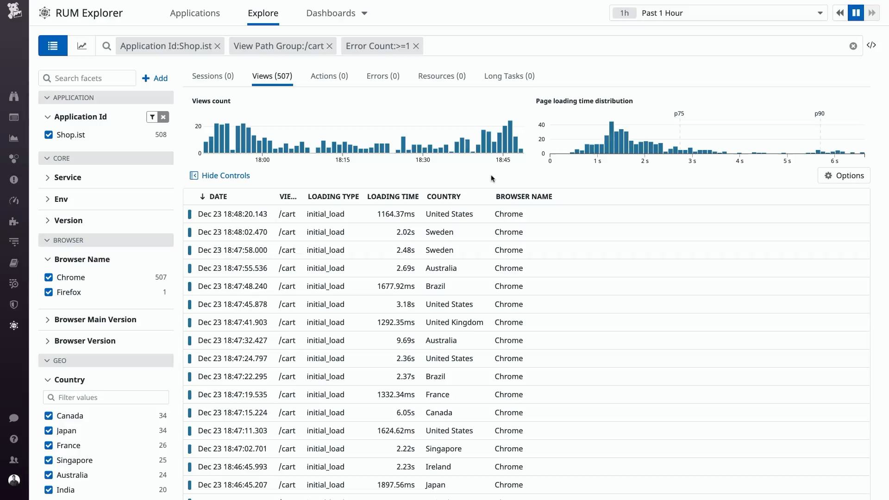
Real User Monitoring

Slide 18
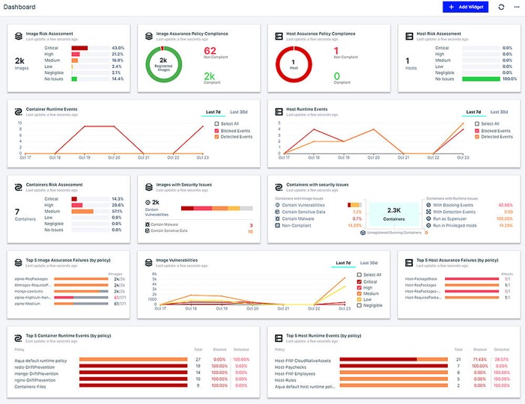
Security Monitoring

Slide 19
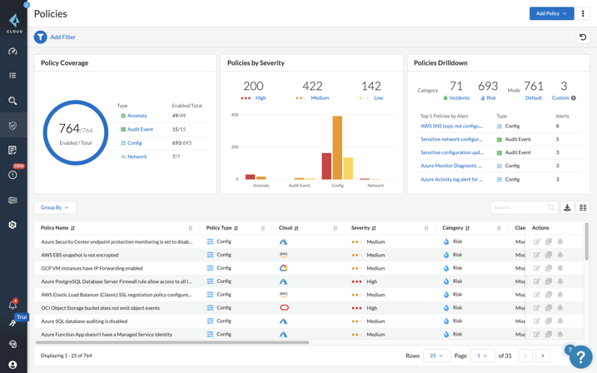
Cloud Security Posture Management (CSPM) & Compliance

Slide 20
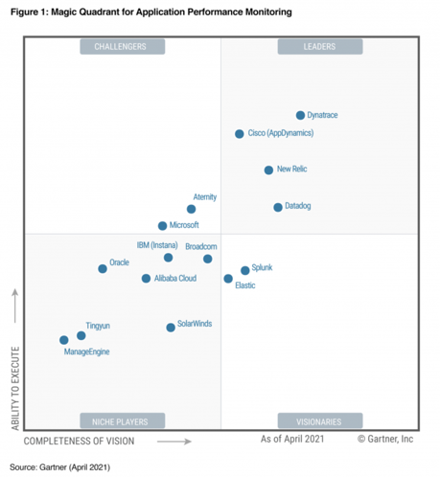
Methodology of Selection
 | Holistic |  |  | Bespoke
 | DataDog | Dynatrace | AppDynamics | Azure | Osmosis | Opensource
Data Centers
Azure | yes | yes | yes | yes | no | yes
Swiss DC | yes | yes | yes | no | yes | yes
Features
Incident Management
Service Visualization
Application Performance Monitoring (APM)
Logging
Infrastructure Monitoring
Synthetic Monitoring
Real User Monitoring
Security Monitoring
Cloud Security Posture Management (CSPM)

